Slide 1
Chapter 3
Section 1 – Animal Reproduction

Slide 2
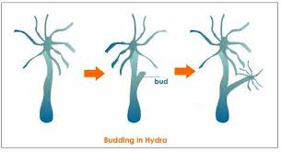
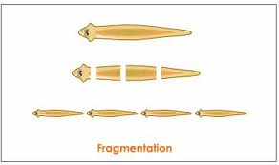
Asexual Reproduction
Single parent has offspring that are genetically identical to the parent
Budding
Fragmentation

Slide 3
Sexual Reproduction
Offspring are formed when genetic information from more than one parent combines.
Male produces sperm
Female produces eggs
Zygote, fertilized egg, is created when the sperm and egg join
This process is called fertilization
Genetic information is found in genes
Genes are located on chromosomes
During fertilization, the eggs chromosomes combine with the sperms chromosomes
This combination of genes during sexual reproduction allows for variation in a population
Allows populations to adapt to changes in the environment over time

Slide 4
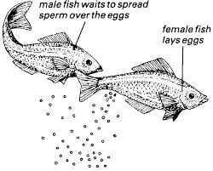
Fertilization
External Fertilization – sperm fertilizes the egg outside of the female’s body
Usually takes place in water, so zygotes will not dry out → frogs, amphibians, fish
Internal Fertilization – egg and sperm join inside the female’s body
Reptiles, birds, mammals, and some fish

Slide 5
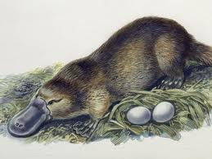
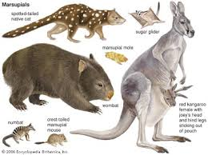
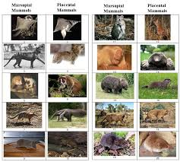
Types of Mammals
Monotreme – mammals that lay eggs
Marsupial – mammals that give birth to partially developed live young
Placental Mammals – mammals nourished inside their mother’s body before birth

Slide 6
Chapter 3
Section 3 – Animal Behavior

Slide 7
Objectives for Section 3-3:
0807.5.3 - Compare and contrast the ability of an organism to survive under different
environmental conditions.
0807.5.4 - Collect and analyze data relating to variations within a population of organisms
SPI 0807.5.3 - Analyze structural, behavioral, and physiological adaptations to predict
which populations are likely to survive in a particular environment.

Slide 8
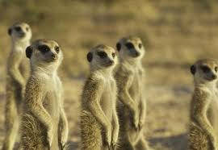
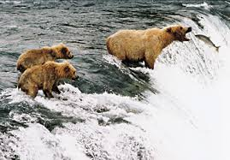
Animal Behavior
Innate Behavior – does not depend on learning or experience → inherited through genes
Learned Behavior – has been learned from experience or observing other animals

Slide 9
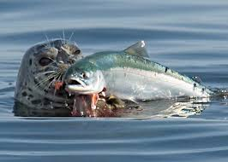
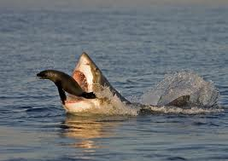
Survival Behavior
Finding food
Predators – animals that eat other animals
Prey – animals that is being eaten
Can an animal be a predator and a prey?

Slide 10
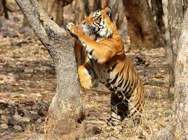
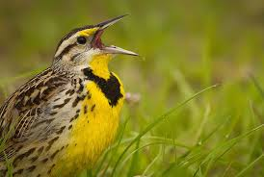
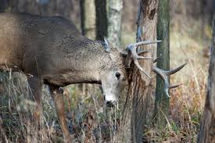
Territory
An area that is occupied by one animal or by a group of animals that do not allow other members of the species to enter
Animals have different ways of marking territories

Slide 11
Defensive Action
Allows organisms to protect resources
Territory
Food
Mates
Offspring
Protect themselves from predators
Some animals fight to defend territory & mates
Some birds use distractions to protect young (pretend to be hurt)
May try to stand very still or outrun
Skunks spray as a defense

Slide 12
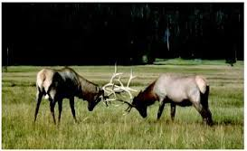
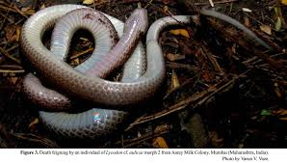
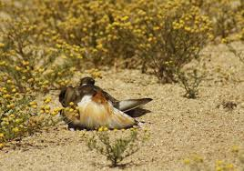
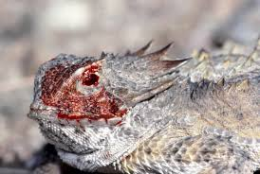
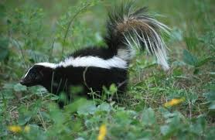

Slide 13
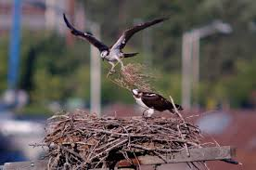
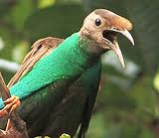
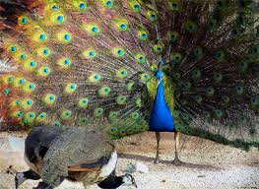
Courtship
Animals have special behaviors that help them find a mate
Mating and reproducing are essential for animal to pass on it’s genes
Build nests to attract mates
Use special movements
Use special sounds

Slide 14
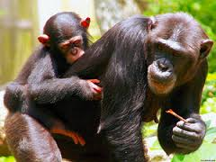
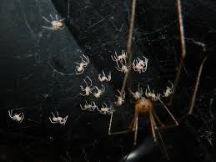
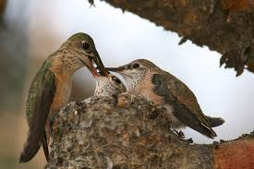
Parenting
Many young animals depend on their parents for survival
Bring food
Teach how to hunt
Parental Investment – teach young so that they can survive to reproduce and pass on genes

Slide 15
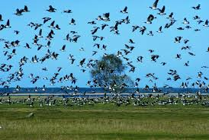
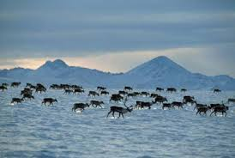
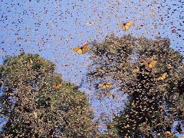
Seasonal Behaviors
Migration – travel to warmer places to find food, water and nesting grounds
Use landmarks – fixed objects that an animal uses to find its way

Slide 16
Seasonal Behavior Continued
Hibernation – period of inactivity and decreased body temperature that some animals experience in winter
Survive on stored body fat
Mice, squirrels, skunks
Temperature, heart rate, breathing rate all drop
Estivation – period of reduced activity in the summer
Desert squirrels and mice slow down in the hottest part of summer
They cannot find food and water in summer heat

Slide 17
Biological Clock
Internal clock of an animal’s natural cycles
Can be used to keep track of daily cycles → circadian rhythyms
Most animals wake up and get sleepy about the same time each day

Slide 18
Chapter 3
Section 4 – Adaptations and Survival

Slide 19
Objectives for Section 3-4:
0807.5.3 - Compare and contrast the ability of an organism to survive under different
environmental conditions.
0807.5.4 - Collect and analyze data relating to variations within a population of organisms
SPI 0807.5.3 - Analyze structural, behavioral, and physiological adaptations to predict
which populations are likely to survive in a particular environment.

Slide 20
Adaptation
Characteristic that improves and individual’s ability to survive and reproduce in a particular environment.

Slide 21
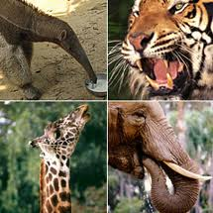
Examples of Adaptations:
*Obtaining Food

Slide 22
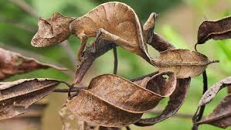
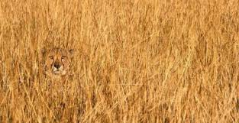
Examples of Adaptations:
Porcupine quills keep predators away
The pattern of coral snakes is a warning sign to predators
Camouflage helps both predators and prey

Slide 23
Examples of Adaptations:
Hawaiian honeycreeper and lobelia plant – adapted to each other over a long period of time
Yucca Moth & Yucca Plant

Slide 24
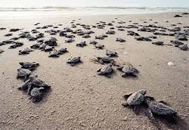
Natural Selection
Process by which individuals that are better adapted to their environment survive and reproduce more successfully.
Only a small % of baby sea turtles survive to reproduce

Slide 25
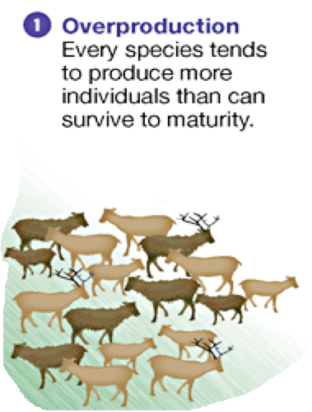
Four Parts of Natural Selection:
Overproduction
More offspring born than will live to become adults

Slide 26
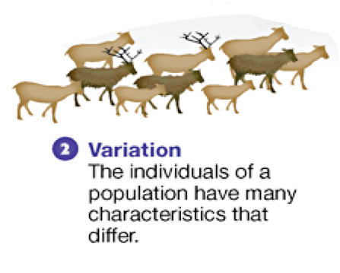
2) Genetic Variation Within a Population
Individuals are different within a population
Some differences increase the chances of survival
While some differences lower the chances of survival

Slide 27
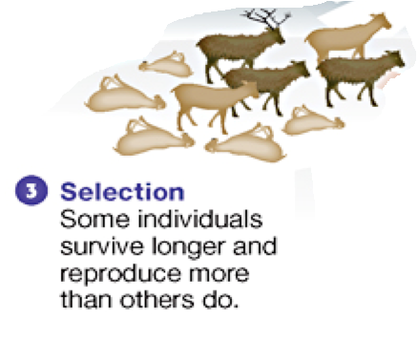
3) Struggle to Survive
An environment might not have enough food or water for every individual
Some might be killed by other organisms
Others cannot find mates

Slide 28
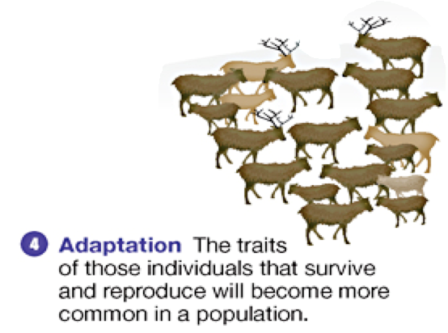
4) Successful Reproduction
Individuals with better adaptations for living in their environment and finding a mate are more likely to reproduce.

Slide 29
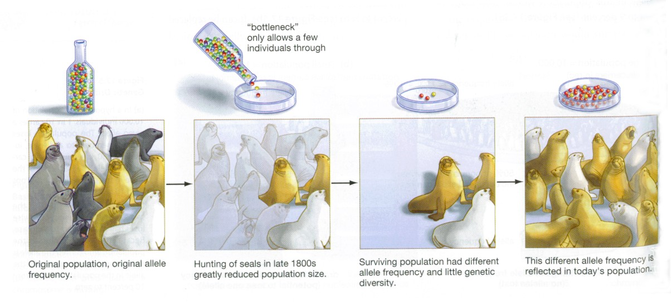
Changes in Genetic Variation
Genetic Bottleneck – reduced number of characteristics within a population

Slide 30
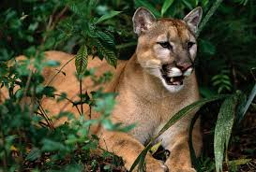
Genetic Bottleneck in Florida Panthers
Isolated from other populations of panthers
Habitat loss
Overall decrease in population size
→ resulted in a smaller population that are genetically similar
→ resulted in inbreeding (heart defects, failure of organs & low birth rate)

Slide 31
Insecticide Resistance
Result of natural selection
Some individuals within a population may be resistant to certain insecticides
They survive to pass on these genes on their offspring
So everytime a population is sprayed, population changes to include more resistant insects.

Slide 32
Chapter 4
Population Changes

Slide 33
Chapter 4 - Section 1
Change Over Time

Slide 34
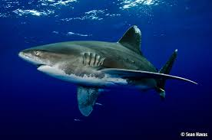
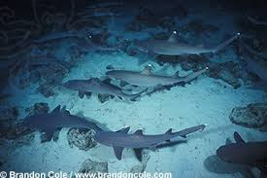
Differences Between Organisms
Species – group of organisms that can mate with one another to produce fertile offspring.
Populations – groups of individuals of the same species living in the same place.

Slide 35
Do Species Change Over Time?
Life ranges from single-celled bacteria to multicellular plants & animals
Scientists think that Earth has changed a great deal over it’s history.
Estimate that the planet is 4.6 billion years old
Many species have died out
Many species have appeared
Scientists think that species change over time and as this happens, new species form → so newer species descend from older species

Slide 36
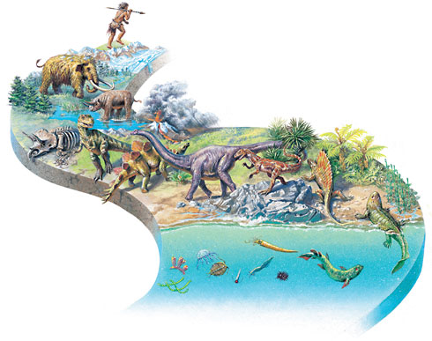

Slide 37
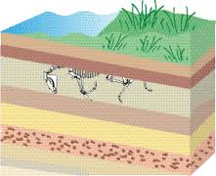
Evidence of Changes Over Time
Evidence buried within Earth’s crust
Made up of different kinds of rock and soil stacked on top of each other called sediments
Sediments – particles of sand, dust or soil are carried by wind or water and deposited in an orderly fashion.
Older layers deposited before newer layers and are deeper in the Earth’s crust.

Slide 38
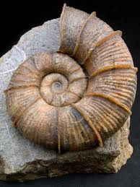
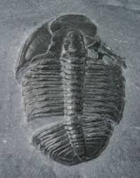
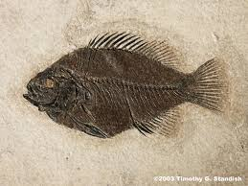
Fossils
Fossils – remains or imprints of once-living organisms found in layers of rock

Slide 39
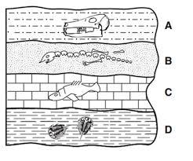
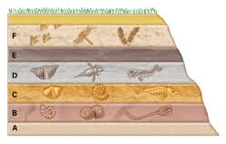
Fossil Record
Organizes fossils by their estimated ages and physical similarities
Fossils in newer layers are more closely related to present-day organisms
Fossils in older layers may not exist anymore
Fossil Record gives evidence about the order in which species existed

Slide 40
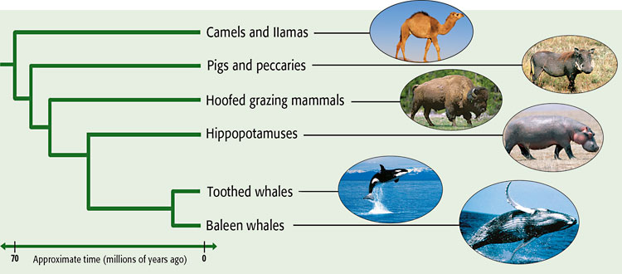
Evidence of Ancestry
Evidence of common ancestors can be found in fossils and living organisms
Examine the fossil record to figure out relationships between extinct and living organisms

Slide 41
Examining Organisms – Evidence of Whale Origins

Slide 42
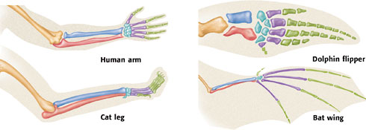
Comparing Organisms
Evidence that groups of organisms have common ancestry can be found by comparing the groups’ DNA
Similarities in structure and function indicate that organisms might have shared a common ancestor.

Slide 43
Comparing DNA Molecules
Scientists analyze DNA, RNA, proteins and other molecules
The greater the number of DNA similarities, the more closely they are related

Slide 44
Section 4-2
How Do Population Changes Happen?

Slide 45
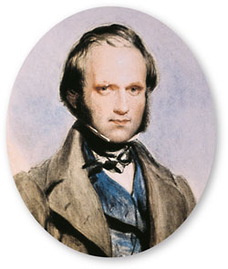
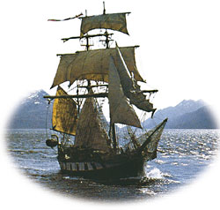
Charles Darwin
Graduated college in 1831 at age of 21
Signed on for a 5 year voyage as a naturalist on the HMS Beagle
Darwin made observations about how things change
Collected thousands of plant and animal samples from around the world

Slide 46
Darwin’s Finches
Darwin noticed that the finches on the Galapagos Islands differed slightly from the finches in Ecuador.
He also noticed that the finches differed from the finches

Slide 47
Why Were These Finches Different
Darwin proposed that the first finches on the islands were blown there by a storm from South America
Over many generations, the finches developed adaptations for the various island environments
Darwin noted that the finch beak size and shape were directly related to the finch’s food.

Slide 48
Ideas About Breeding
Trait – form of hereditary characteristic
Selective Breeding – humans select plants or animals for breeding based on desired traits

Slide 49
Thomas Malthus
Wrote a book called An Essay on the Principle of Population
He noted that humans have the potential to reproduce rapidly
He warned that food supplies couldn’t support such a rapid growth
He noted that human population is limited by disease, starvation and other factors
Darwin realized that this applied to all species
Only a limited number of individuals in any population live long enough to reproduce

Slide 50
Natural Selection
Process by which individuals that are better adapted to their environment survive and reproduce more successfully.
Only a small % of baby sea turtles survive to reproduce

Slide 51
Four Parts of Natural Selection:
Overproduction
More offspring born than will live to become adults

Slide 52
2) Genetic Variation Within a Population
Individuals are different within a population
Some differences increase the chances of survival
While some differences lower the chances of survival

Slide 53
3) Struggle to Survive
An environment might not have enough food or water for every individual
Some might be killed by other organisms
Others cannot find mates

Slide 54
4) Successful Reproduction
Individuals with better adaptations for living in their environment and finding a mate are more likely to reproduce.

Slide 55
Natural Selection in Action
Bacteria resistant to antibiotics – those will survive to reproduce
Elephant hunting in Uganda – 15% of all male elephants born without tusks
Insecticide resistance
Generation Time – average time between one generation and the next
The shorter the generation time – the more quickly natural selection takes place
Competition for mates – some females prefer certain traits

Slide 56
Forming a New Species
New species may form after a group becomes separated from the original population
Over time the population adapts to its new environment
Eventually, the new population and the original population differ so much that they can no longer mate successfully
Speciation – the formation of a new species as a result of change over time
Canyon, lake, mountain range, forest fire
This shows how the new species of Galapagos finches may have formed

